Slide 1
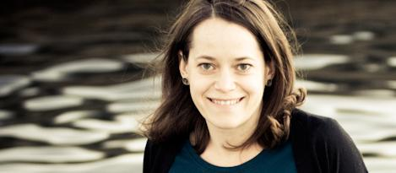
next library 2011
Notes:
Thank you so much for joining us today. It’s a pleasure to be here moderating this discussion about community building and libraries – a topic that’s extremely dear to my professional interests. In today’s session we are going to hear from four presenters – each giving very brief presentations on their work building local communities through their libraries. Each presenter will propose a question to this audience, and then we will interactively, in a world café model, discuss their questions, moving about the room, building on the discussions of each participant over the course of our time together.
I’ll talk in a bit about how the interactive portion will work, but first I’d like to introduce our panelists and then frame today’s discussion by talking about some research that I completed in 2009 on this topic …
[insert short bio sentence on each panelists here]

Slide 2
who is doing it ?
how are they doing it ?
what have they learned ?
Notes:
… research into the central questions in what has now been a decade of my work in libraries. Published last year by ALA Editions, I set out to investigate who was doing community building work in libraries, how they were going about it, and what they had learned through those experiences that I could aggregate and share back to the field, and that we could all learn from.

Slide 3
Book stores.
Pubs.
Documents.
Bowling Alleys.
Notes:
I started by going back to some of the things that I had explored through my studies in library school.
Ray Oldenburg; great good places
John Seely Brown; the social life of documents
Robert Putnam; bowling alone
All of these authors exploring the spaces and the services that form tight communities.

Slide 4
Notes:
I also recalled the critical conversations that I’d had with my colleagues in library school…this is my friend Matt Turpin who said to me after a lecture on information needs … we were talking about whether or not our local public library was meeting those needs … he said to me the most important information need that I have is: what are my friends doing. And this was before the participatory web had really exploded into the mainstream, where it is today.
And finally I drew on my experiences working in libraries.

Slide 5
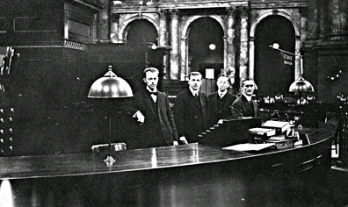
Notes:
-----
This is a Photo: LOC 1906
Fortunately or unfortunately, when I first saw this photograph, I recognized this space as the library I worked in, I recognized these faces as the faces of some of my colleagues. In essence,*not much had changed*
My colleague Joe Janes recently said that if this were a photo of a medical operating room, we’d hope that *something* had changed 100 years later. Not so much, I’m afraid, could be said for the experiences that I had in my early career.

Slide 6
Where is the library
?
Notes:
So, where was the library that I had imagined in library school. That I was starting to uncover monthly. Weekly, daily in my work at WebJunction.org – a learning community for library staff.

Slide 7
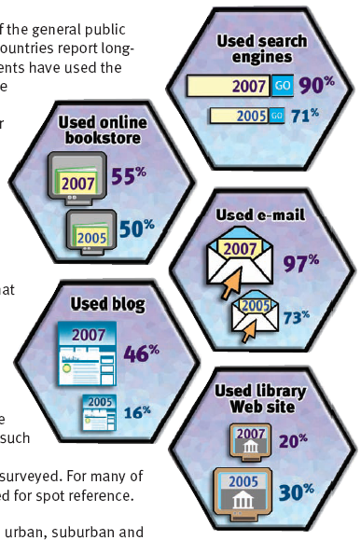
Uh-oh.
Notes:
Coincidentally, OCLC published a study a that told us that while many other ways of exploring online were up up up using the library website was down by 10% from three years before.
As a new librarian, this didn’t make sense to me. IN spite of my vision for libraries, in spite of what I knew many libraries were doing, incredible things, Why are we out of the loop?
Source: http://www.oclc.org/reports/sharing/default.htm

Slide 8
Notes:
I talked to hundreds of librarians over the course of the nearly three years working on this project, in order to answer these questions. What we learned is that there were at least five critical concepts or practices for the librarians who value community building as part of their work.
I’m going to talk about each of the a little bit today.

Slide 9
Notes:
First, community building librarians are obsessed with local needs. They actively and proactively seek continuous input about what’s happening in their community and what their patrons are asking for. Not to get to far ahead of myself here, but they also try to get it for them, and coincidentally, it fills the library…

Slide 10
Notes:
Which is a great segue to, community building librarians Deliver. I open this chapter with a collection of interviews and transcripts from the librarians I talked to, but embedded in all of these is a strong focus on service, and human interaction, even over books and materials.

Slide 11
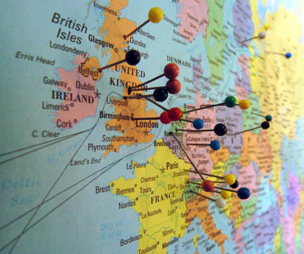
Notes:
Next, community building librarians Engage. This is a little bit about marketing, which can be daunting to some. But doesn’t have to be complicated. In this chapter I tell the story of Molly Rogers – Wayne County Public Library, rural library in Pennsylvania.
Realized they had a lot of patrons coming in during the summer months from all over the world to use public access computers; asked patrons to put a pin on the map, and then write down wehre they were from on a legal pad.
A year later, they realized that a growing diversity of users who lived right in the same county … but who had immigrated from all over the wrold.
The physical map helped them partner with organizations that share a global perspective, like their local Rotary, and they were able to get new and matching funds for more public access computers.

Slide 12
Notes:
And then, our community building librarians talked about formal evaluation.
As a result of a formal evaluation program in Hartford, the library can now better anticipate their community needs … and they were recognized nationally as a model for proactive community service through a study supported by Univ of Michigan and IMLS.
When I asked her about any advice that she might have for librarians just trying to figure this out, she said. Make it a priority. “The rewards are enormous.”

Slide 13
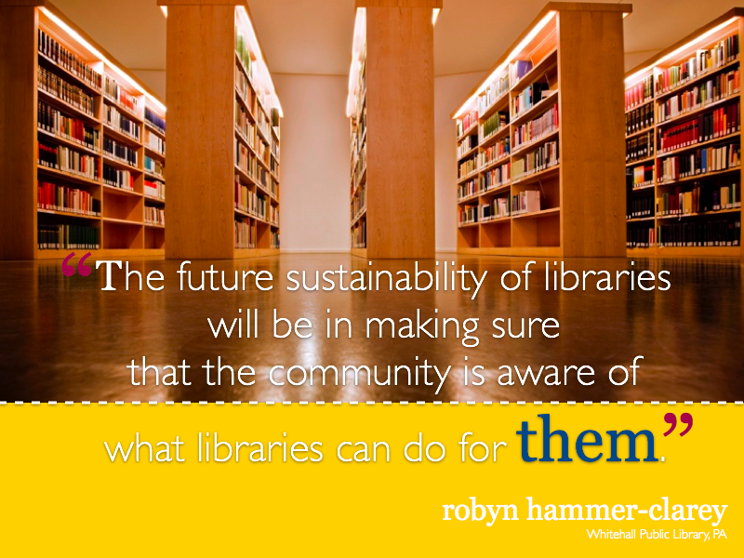
Notes:
In all of our interviews, and underlying all of these other concepts was the librarians’ strong desire to keep library services relevant, to ensure that we’re staying in constant communication with our users about those services, so that the library could remain viable for the long term.

Slide 14
Is your library relevant?
How do you know ?
Notes:
I’ll close by saying that this is not a recipe for community building success in your library. It’s just a collection of the concepts and practices that surfaced in my research for this work. Our panelists today are going to talk a bit more, and a bit differently, about community building and libraries from their experiences. I’d ask this audience, as we head into the remainder of our program, to bring some consideration of your local communities. Do you know what the needs are? Is your library actively working to meet those needs? How do you know you’re successful in meeting them?
And with that, I’ll turn it over to [determine order of presenters here]
After last presentation, describe world café model. Ask for two video recorder volunteers.

