Slide 1
next library 2011
Notes:
Thank you so much for joining us today. It’s a pleasure to be here moderating this discussion about community building and libraries – a topic that’s extremely dear to me

Slide 2
Workshop Instructions
1. listen 5x7
2. discuss 4x10
3. share back 5x3
Notes:
. In today’s session we are going to hear from four presenters – each giving very brief presentations on their work building local communities through their libraries. Each presenter will propose a question to this audience, and then we will interactively, in a world café model, discuss their questions, moving about the room, building on the discussions of each participant over the course of our time together.
1. listen (5 x 7 = 35)
Each speaker ends with a question. We will ring the bell when time to stop.

Slide 3
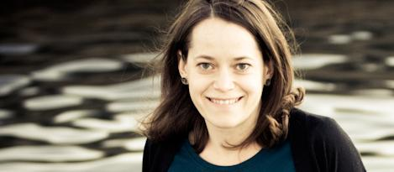
next library 2011
Notes:
I’ll talk in a bit about how the interactive portion will work, but first I’d like to introduce our panelists and then frame today’s discussion with some introductory comments …

Slide 4
who is doing it ?
how are they doing it ?
what have they learned ?
Notes:
In 2007, I started research to answer some basic questions about how communities and libraries were interacting; I set out to investigate who was doing community building work in libraries, how they were going about it, and what they had learned through those experiences that I could aggregate and share back to the field, and that we could all learn from.

Slide 5
Notes:
I talked to hundreds of librarians over the course of the nearly three years working on this project, in order to answer these questions. What we learned is that there were at least five critical concepts or practices for the librarians who value community building as part of their work.

Slide 6
Notes:
First, community building librarians are obsessed with local needs. They actively and proactively seek continuous input about what’s happening in their community and what their patrons are asking for. Not to get to far ahead of myself here, but they also try to get it for them, and coincidentally, it fills the library…

Slide 7
Notes:
Which is a great segue to, community building librarians Deliver. I open this chapter with a collection of interviews and transcripts from the librarians I talked to, but embedded in all of these is a strong focus on service, and human interaction, even over books and materials.

Slide 8
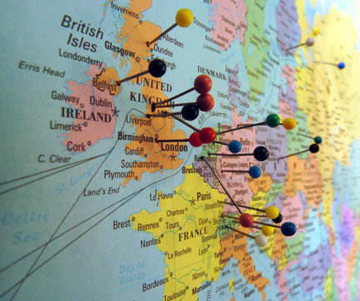
Notes:
Next, community building librarians Engage. This is a little bit about marketing, which can be daunting to some. But doesn’t have to be complicated. In this chapter I tell the story of Molly Rogers – Wayne County Public Library, rural library in Pennsylvania.
Realized they had a lot of patrons coming in during the summer months from all over the world to use public access computers; asked patrons to put a pin on the map, and then write down where they were from on a legal pad.
A year later, they realized that a growing diversity of users who lived right in the same county … but who had immigrated from all over the world.
The physical map helped them partner with organizations that share a global perspective, like their local Rotary, and they were able to get new and matching funds for more public access computers.

Slide 9
Notes:
And then, our community building librarians talked about formal evaluation.
As a result of a formal evaluation program in Hartford, the library can now better anticipate their community needs … and they were recognized nationally as a model for proactive community service through a study supported by the federal institute for libraries and museums in the US.
When I asked her about any advice that she might have for librarians just trying to figure this out, she said. Make it a priority. “The rewards are enormous.”

Slide 10
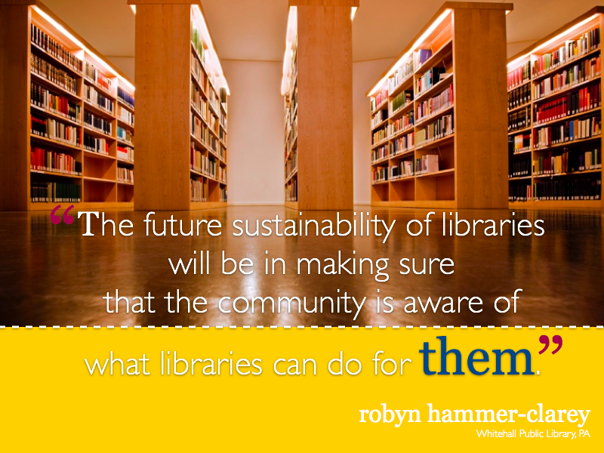
Notes:
In all of our interviews, and underlying all of these other concepts was the librarians’ strong desire to keep library services relevant, to ensure that we’re staying in constant communication with our users about those services, so that the library could remain viable for the long term.

Slide 11
Is your library relevant?
How do you know ?
Notes:
I’ll close by saying that this is not a recipe for community building success in your library. It’s just a collection of the concepts and practices that surfaced in my research for this work. Our panelists today are going to talk a bit more, and a bit differently, about community building and libraries from their experiences.
I’m so excited that, several years after starting this work, the conversation continues. That I’m still connecting with librarians from around the globe on these topics.
Today we will hear from:
Irina on the topic of young users. Irina is from Fergana Regional Information-Library Center in Uzbekistan and works for the foreign language and IT department to develop new modern services for their users. She’s going to discuss a chat club that she has organized for her library.
And on the theme of participation, Nicola is a librarian, originally from the UK, working alongside the library’s designer Anna, a recent graduate of participatory design. They will talk about a new library space at Palmerson North City Library in New Zeleand. Nicola and Anna are presenting virtually by video, and Brian Bannon, Chief Information Officer at the San Francisco Public library, will facililtate their discussion.
On the topic of Commitment, Elisee joins us from Friends of African Village libraries, where he is responsible for nine departments. He’s asking for your help today, to extend learning and literacy in Burkina Faso.
And finally, we’ll hear from Omar on the topic of community needs. Omar is a librarian working with Kenya National library Service as a resource mobilization officer. With the help of a committed team spear-headed by their director, they are working on five new projects in 20 branch libraries across Kenya.
I’d ask this audience, as we head into the remainder of our program, to bring some consideration of your local communities to this discussion and to our panelists questions. Do you know what your community’s needs are? Is your library actively working to meet those needs? How do you know you’re successful in meeting them?
And with that, I’ll turn it over to Irina …
After last presentation, describe world café model. Ask for two video recorder volunteers.

Slide 12
Workshop Instructions
1. listen 5x7
2. discuss 4x10
3. share back 5x3
Notes:
Workshop Instructions
2. discuss (4 x 10 = 40)
Discuss your perspectives on each of our questions. Spend 10 minutes at each station. We will ring the bell when time to change to the next question.
3. share back (5 x 3 minutes = 15 minutes)
Each discussion leader shares the “full story” of our answers to their question during this workshop.

