Slide 1
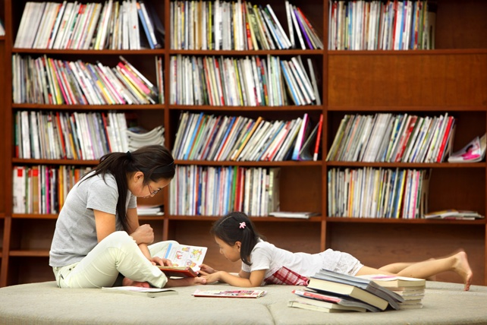
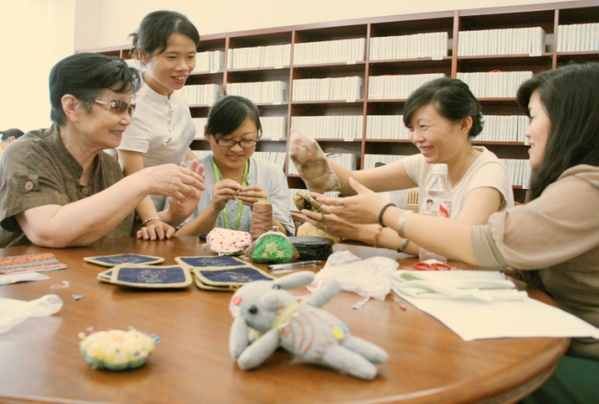
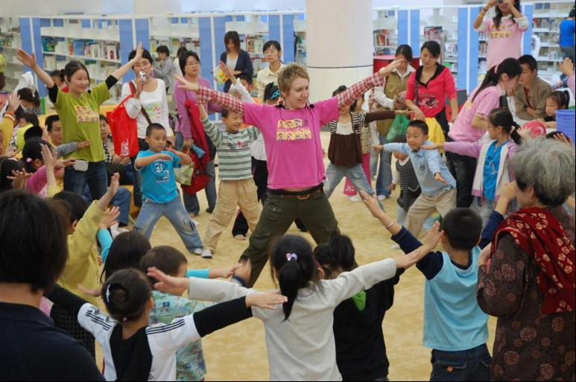
公共图书馆：公众的“第三文化空间”
Public Library: “The Third Cultural Space” For Citizens
杭州图书馆 褚树青
Chu Shuqing / Hangzhou Public Library

Slide 2
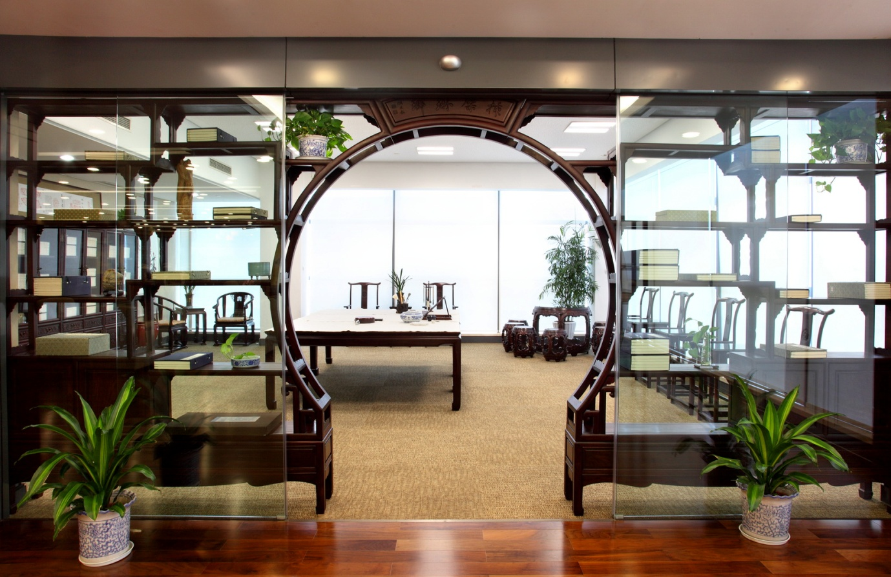
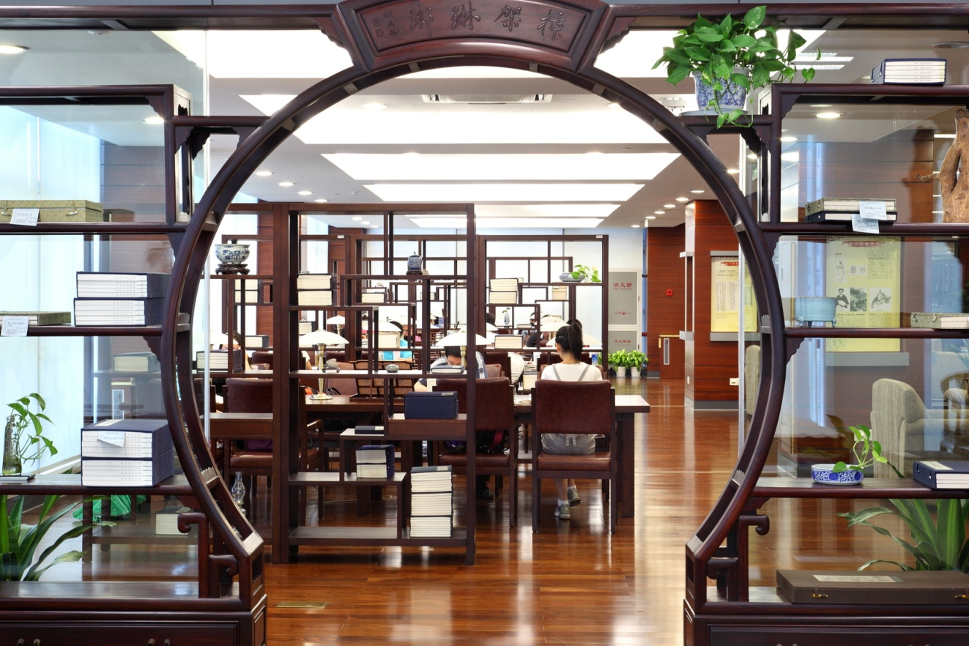
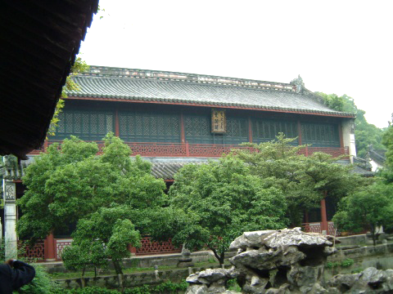
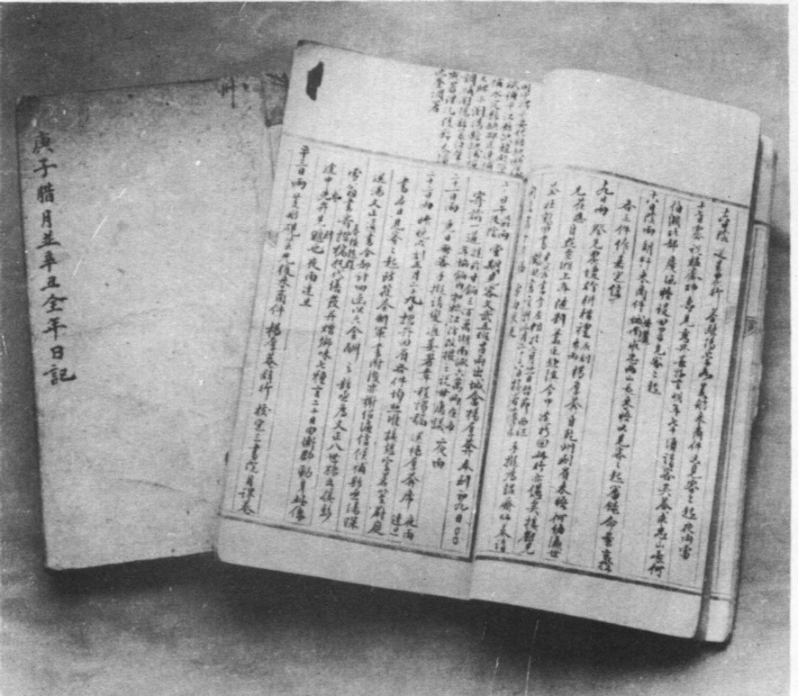
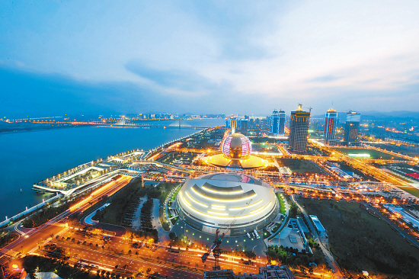
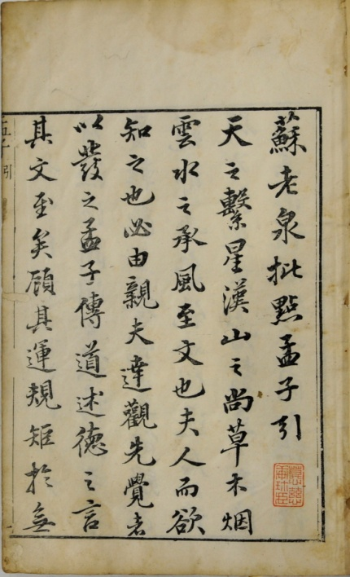
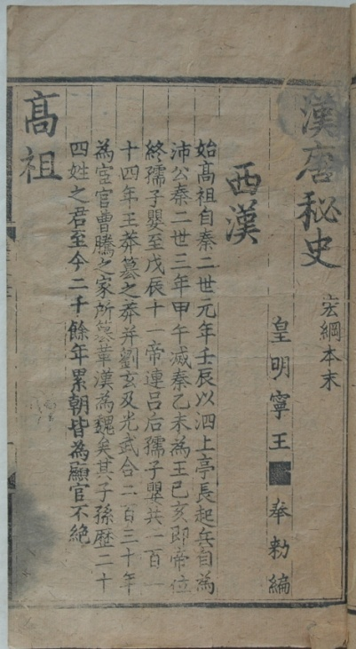
一、引言：杭州和杭州图书馆
1. Foreword: Hangzhou and Hangzhou Public Library
文澜阁
Wenlan Pavilion
书画室
Painting&Calligraphy Room
古籍、地方文献
Ancient Books and Local Documents
古籍阅览区
Ancient Books Reading Room
钱江新城
New City ,Hangzhou
杭州西湖
West Lake, Hangzhou
王文韶日记
Notes:
一、引言：杭州和杭州图书馆
杭州是一个具有悠久历史的文化古城，是八百多年前中国的首都，有着五千多年的建城史，曾被意大利著名旅行家马可·波罗赞为“世界上最美丽华贵之城”。
杭州是中国最负盛名的刻书、藏书中心之一，也是中国最早引进西方公共图书馆理念的城市，但其具有百年历史的公共图书馆现已成为省立图书馆，我所在的杭州图书馆是市立图书馆，有着五十多年的历史。
杭州图书馆秉承了杭州这座城市深厚的文化底蕴和人文积淀，收藏有大量的古籍、地方文献及名人手稿等各类文献资源，这些丰富而且多元的馆藏资源是杭州图书馆开展各种文献服务的基础。
1、Foreword：Hangzhou and Hangzhou Public Library
Hangzhou is an ancient cultural city with more than 5000 years of history, and was the Capital of China in Southern Song Dynasty around 800 years ago. It was commended by the famous Italian traveler, Marco Polo, “the most beautiful and magnificent city in the world”.
Hangzhou is one of the famous centers in China for book engraving and collection, and the first city which imported western public library ideal (???). The public library in Hangzhou with a hundred years of history has already become a provincial library. The Hangzhou Public Library I worked in is the municipal library with more than 50 years’ history.
Hangzhou Public Library inherited deep cultural heritage, with an abundance of ancient books, local documents, writers' manuscripts and all sorts of literature resources. The rich and diverse collection provides a base for Hangzhou Public Library to carry on all kinds of literature services.

Slide 3
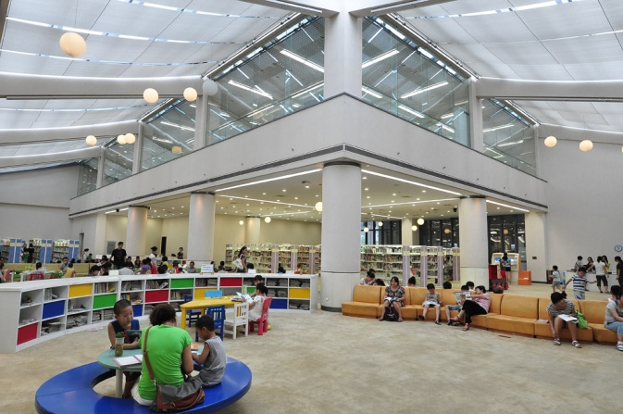
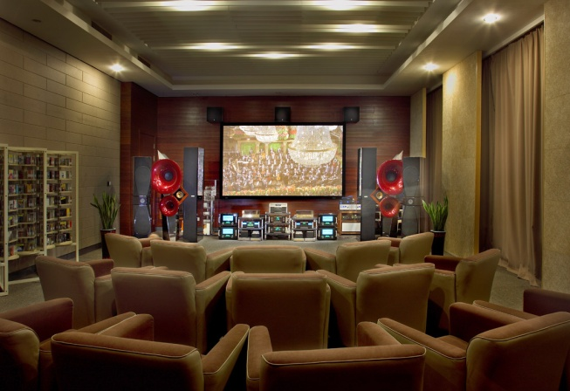
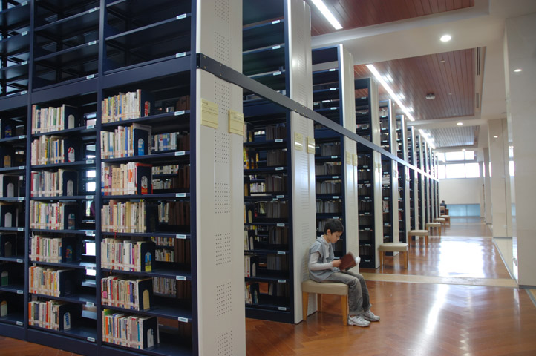
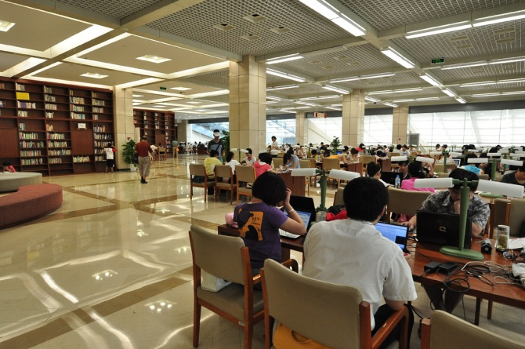
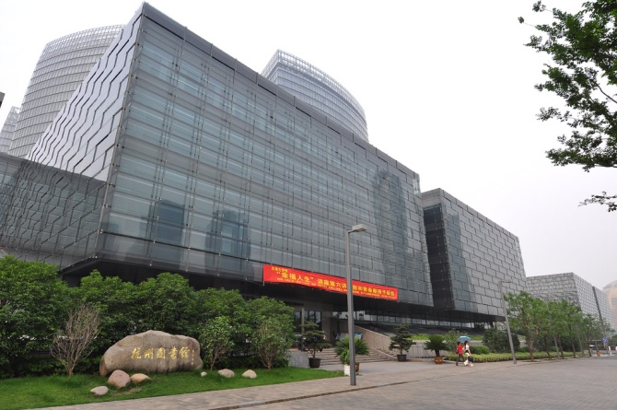
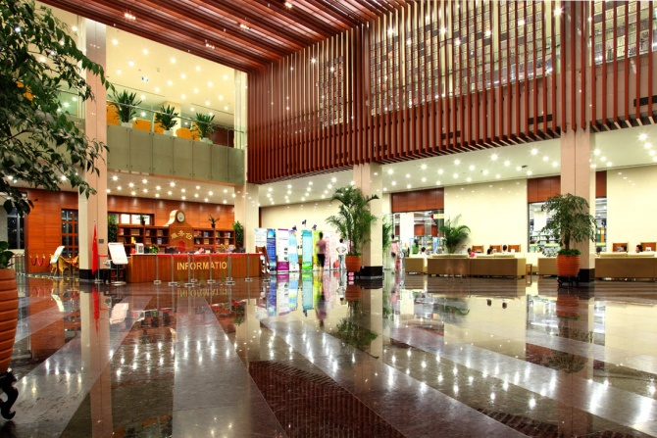
二、市民大书房
文献借阅中心
Book Circulation
图书馆外景
Library Outdoor Scene
儿童服务区
Children Service Area
Hi-Fi音乐室
Hi-Fi Room
服务大厅
Service Lobby
2. Study Room for the Citizens
– To be the Best City Library in China
自修区
Study Area

Slide 4
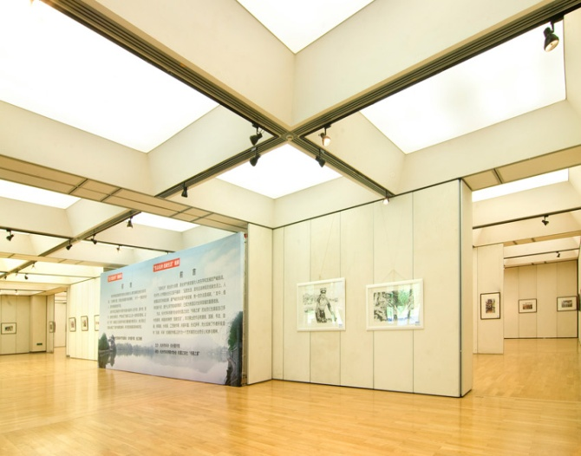
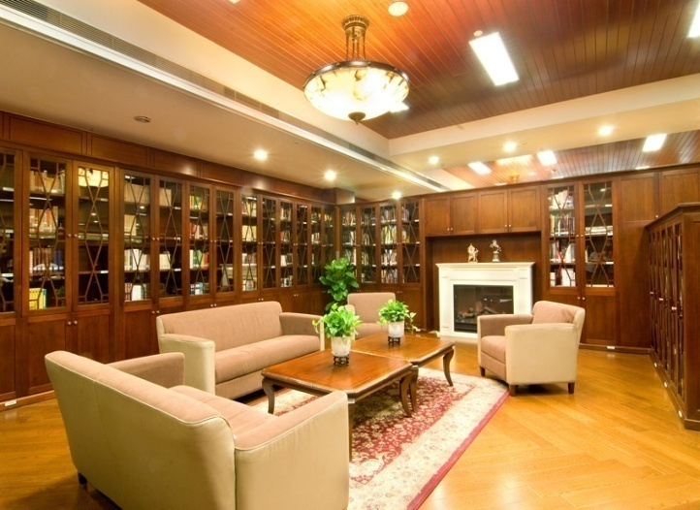
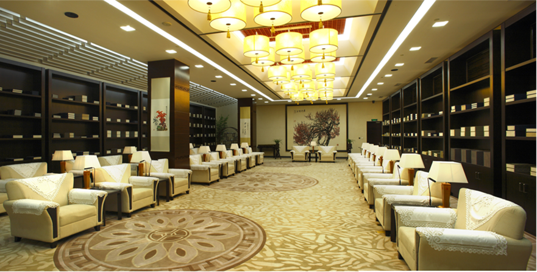
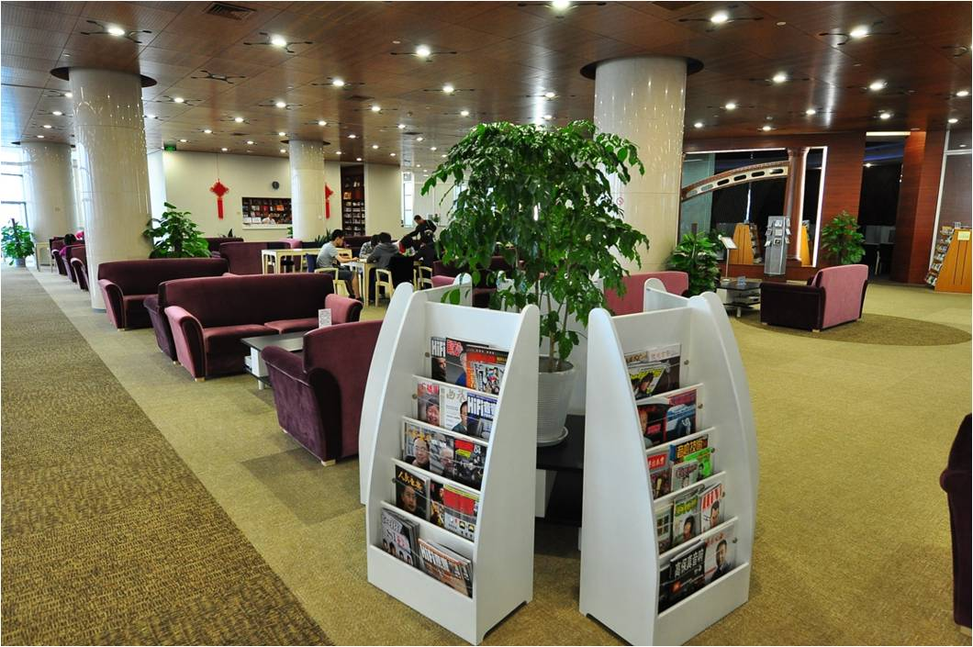
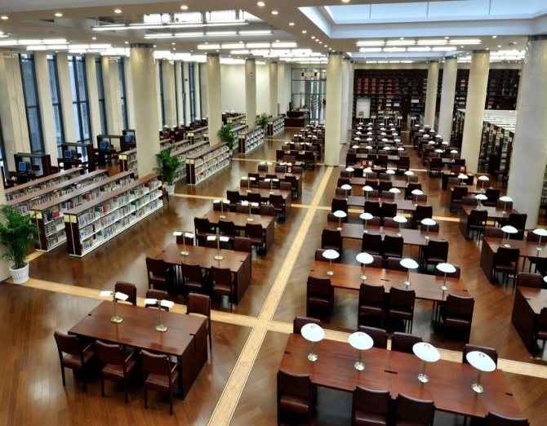
二、市民大书房
展览厅
Exhibit Hall
西文阅览区
Western Language Reading Area
音乐欣赏区
Music Appreciation Area
交流室
Meeting Room
2. Study Room for the Citizens
– To be the Best City Library in China
专题文献中心
Special Collection

Slide 5
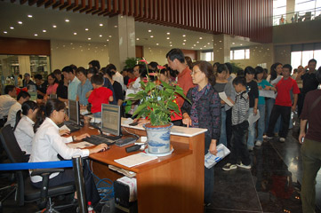
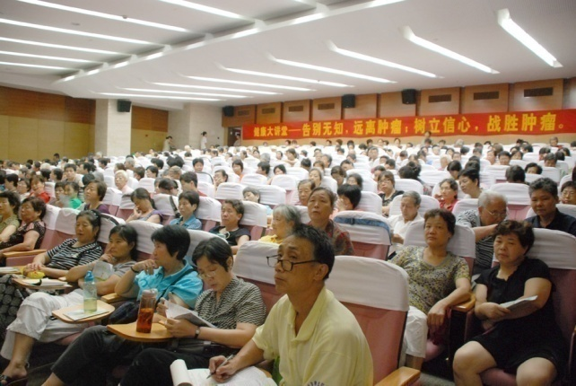
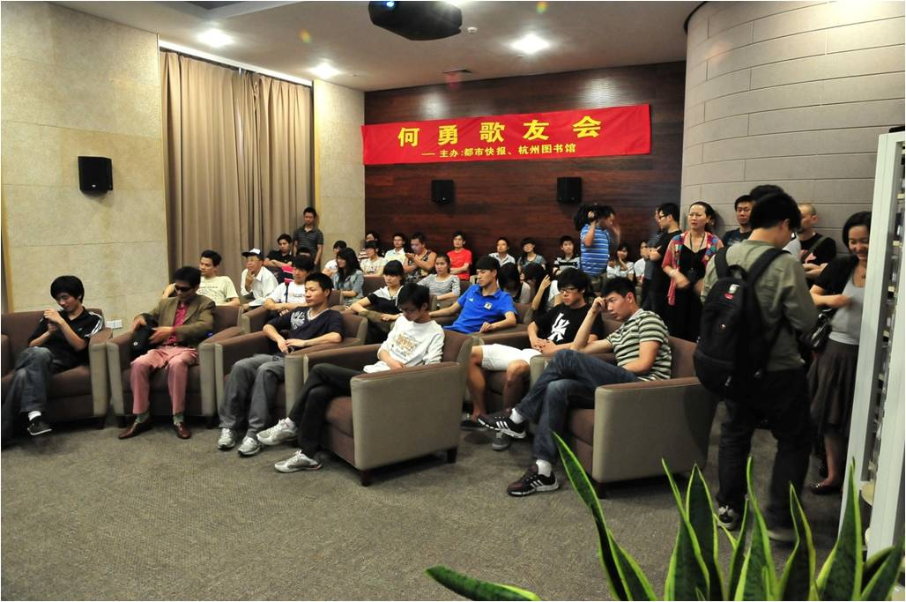
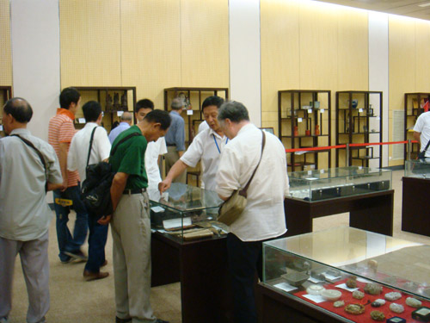
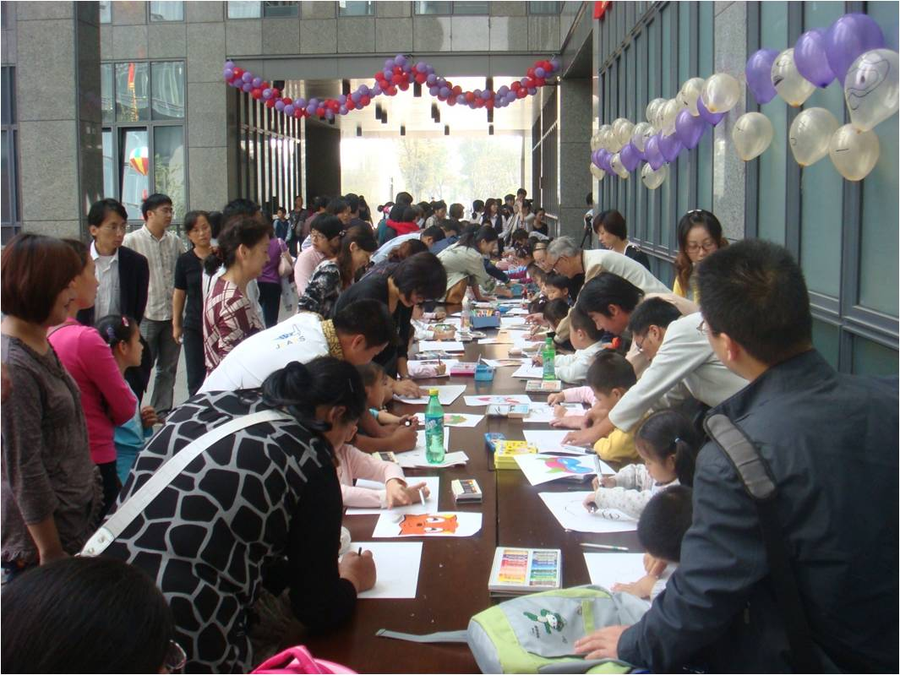
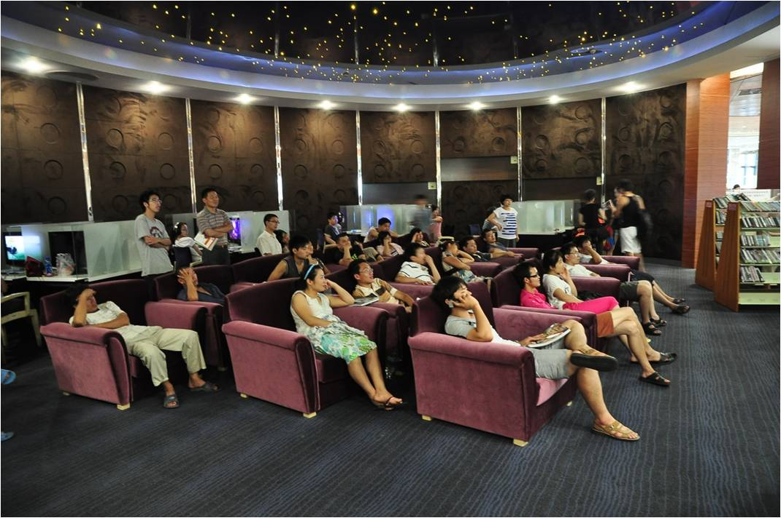
二、市民大书房
2. Study Room for the Citizens
– To be the Best City Library in China
各类活动
Kinds of Activities

Slide 6
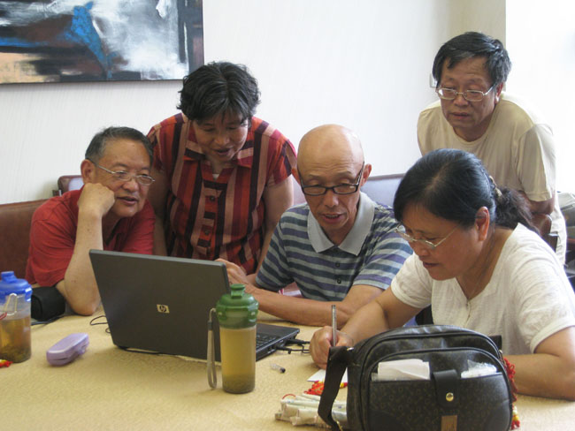
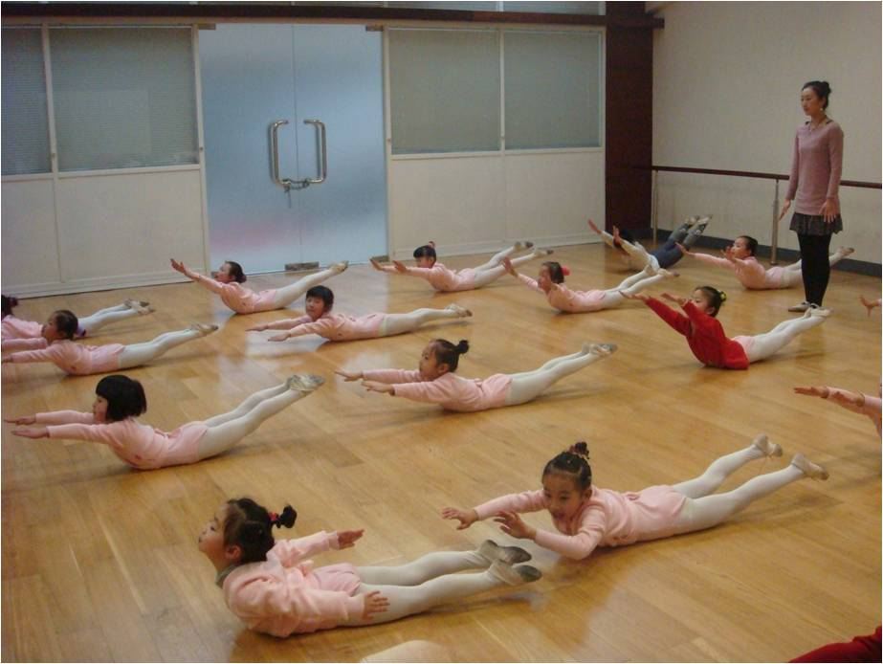
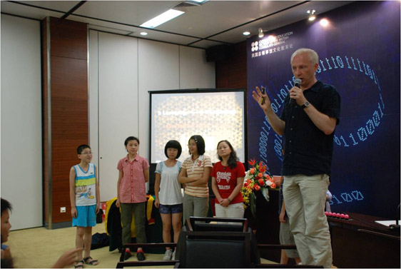
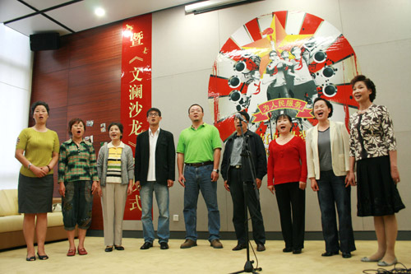
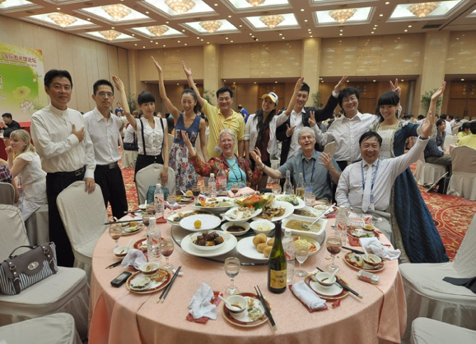
二、市民大书房
各类活动
Kinds of Activities
2. Study Room for the Citizens
– To be the Best City Library in China

Slide 7
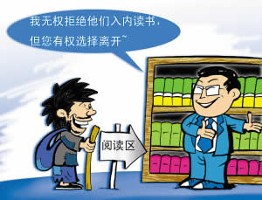
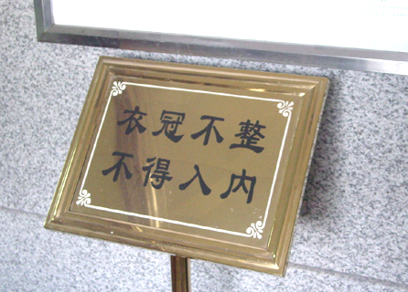
平民图书馆
Library for the Common People- To be an open space for all
平等 免费 无障碍
Equality,Free of Charge and No-barrier

Slide 8
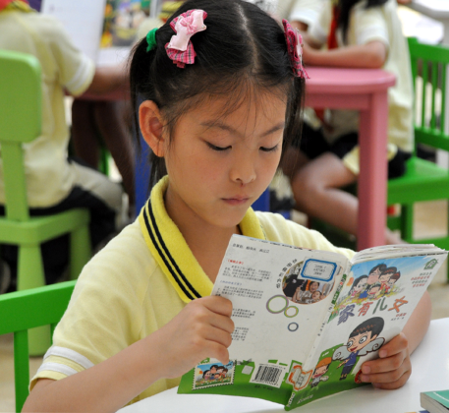
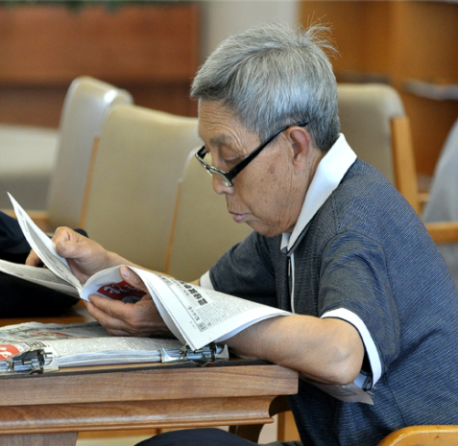
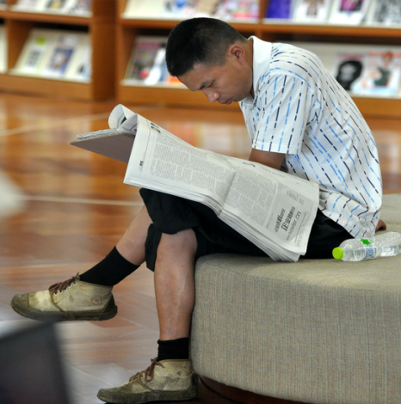
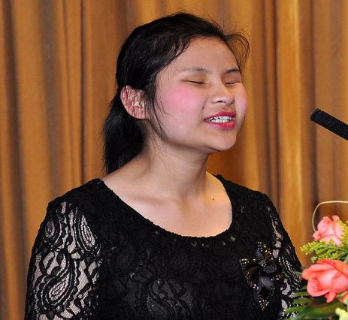
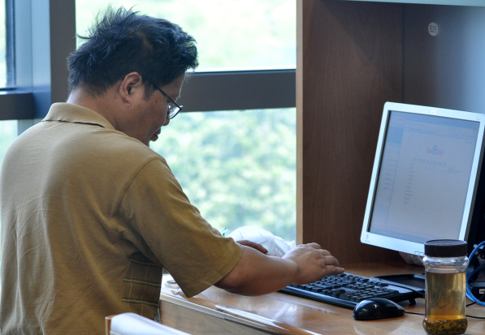
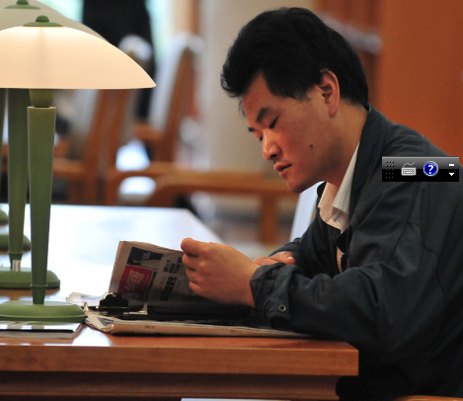
平等 免费 无障碍
各类人群
Sorts of groups
Equality,Free of Charge and No-barrier

Slide 9
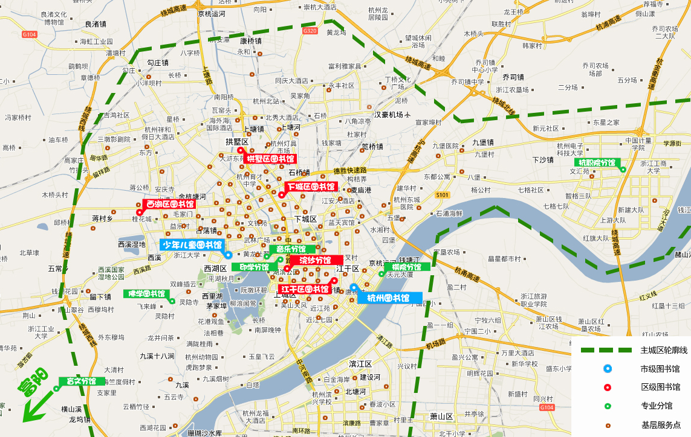
市区分馆、基层点分布图
Distribution Map of City Branch Library and Grass Roots Points

Slide 10
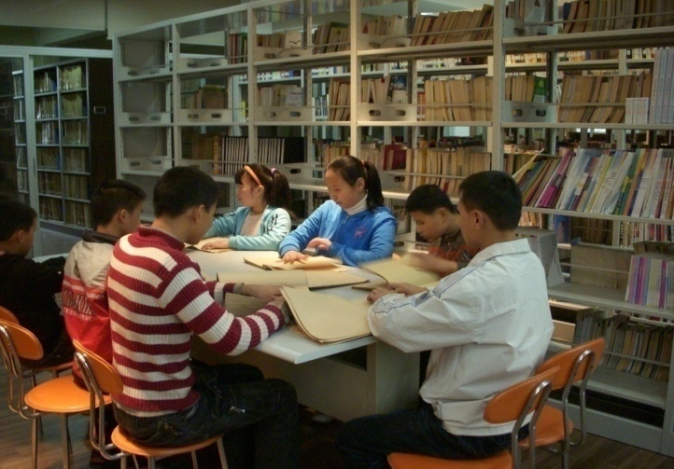
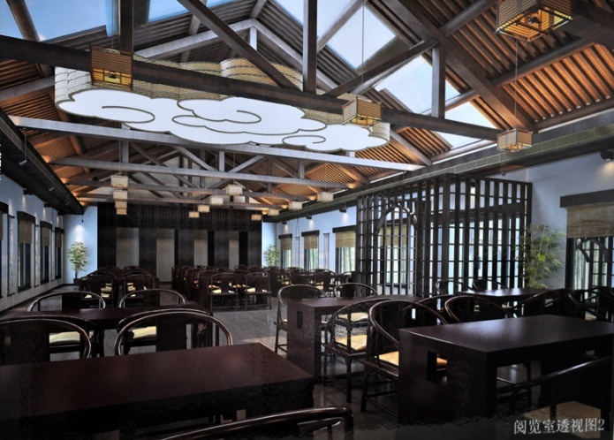
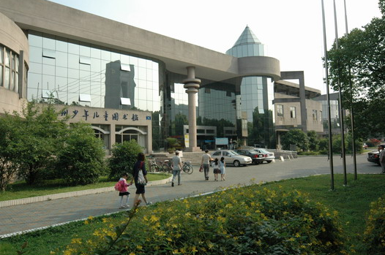
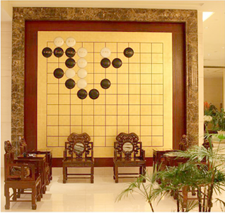
平等 免费 无障碍
特色分馆
Special Branch
Equality,Free of Charge and No-barrier

Slide 11
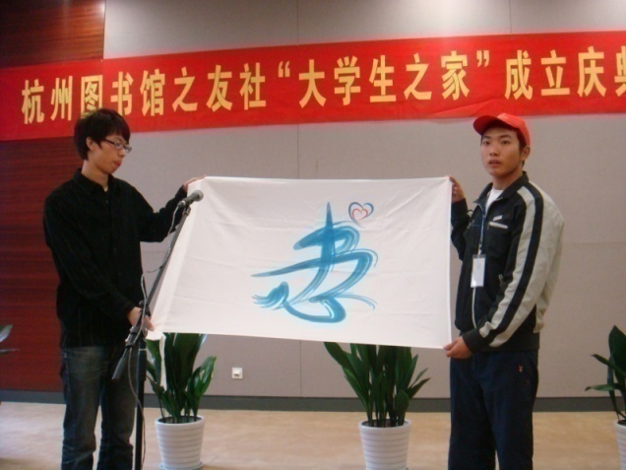
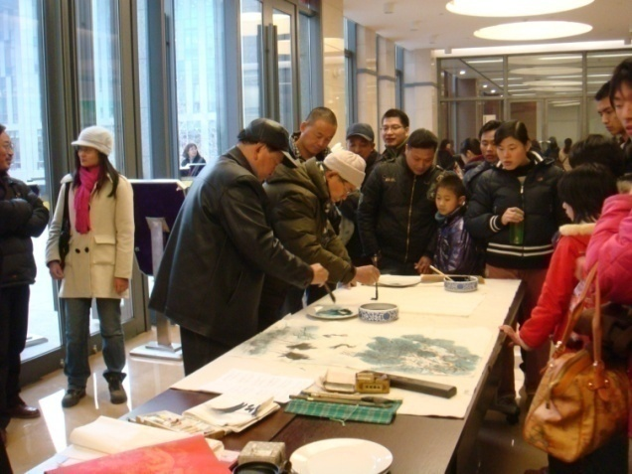
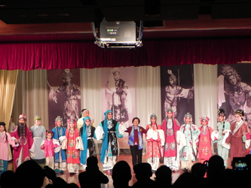
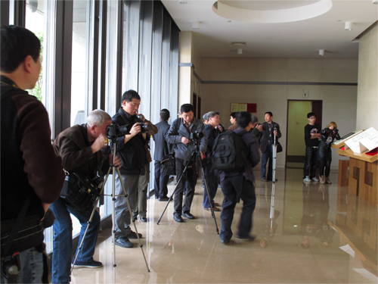
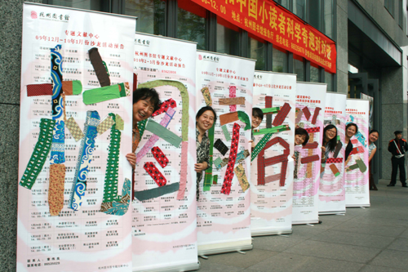
三、市民参与管理
各类社团
3. Citizen Participation and Management
Sorts of societies

Slide 12
四、经济欠发达地区图书馆：我们机体的一部分
4. Libraries in Less Developed Area:One Part of Our Body
杭州图书馆成立全国第一家图书馆事业基金会
Hangzhou public library founded the first library foundation in China

Slide 13
四、经济欠发达地区图书馆：我们机体的一部分
4. Libraries in Less Developed Area:One Part of Our Body
杭州图书馆创办“开明●文澜爱心图书馆”
Hangzhou public library establish “Kaiming Wenlan Loving Care Library”

Slide 14
五、“送什么都不如送电脑”
5.“There is no better thing than computers to present”
杭州数字图书馆
Hangzhou Digital Library

Slide 15
五、“送什么都不如送电脑”
5.“There is no better thing than computers to present”
Library registered users
enjoying mobile service
图书馆注册用户登陆
享受手机服务
杭州地区（除高校外）
IP地址用户直接访问
网站数字资源
杭州有线电视用户
通过华数交互式机顶盒
访问电视资源
免费使用
数字图书馆
Digital library free of charge
Users in the IP address of hangzhou
Area(expect universities) can access it
(digital resources in the website) directly
Hangzhou cable television users
Access TV resources by interactive TV set-top box

Slide 16
五、“送什么都不如送电脑”
5.“There is no better thing than computers to present”

Slide 17
六、公共图书馆：“第三文化空间”
6. Public Library: “The Third Cultural Space”

Slide 18
Thank You!

